Slide 1
Edge Computing
Lecture 05: Basics of ML

Slide 2
Recap
Edge System Evaluation
System Metrics vs Performance Metrics
Edge System Optimization
Architecture design
Device optimization
Concurrency
SIMD
Threading & Multiprocessing

Slide 3
Agenda
Neural network: terminology
Common building block: layer
Convolution neural network
Lab 2: object detection

Slide 4
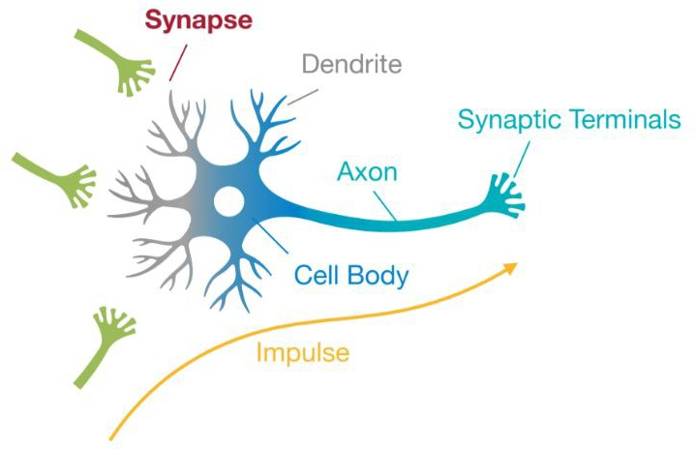
Neuron
Synapse: a small gap at the end of a neuron that allows a signal to pass from one neuron to the next
Dendrite: a short branched extension of a nerve cell, along which impulses received from other cells at synapses are transmitted to the cell body.
Axon (Nerve fiber): The long portion of a neuron that conducts impulses away from the body of the cell.
https://hanlab.mit.edu/courses/2023-fall-65940

Slide 5
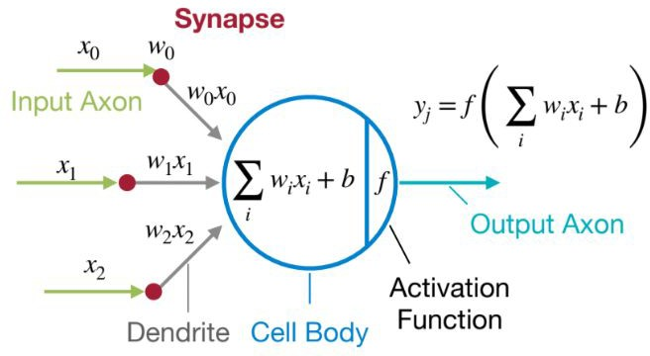
Modeling Neuron
https://hanlab.mit.edu/courses/2023-fall-65940

Slide 6
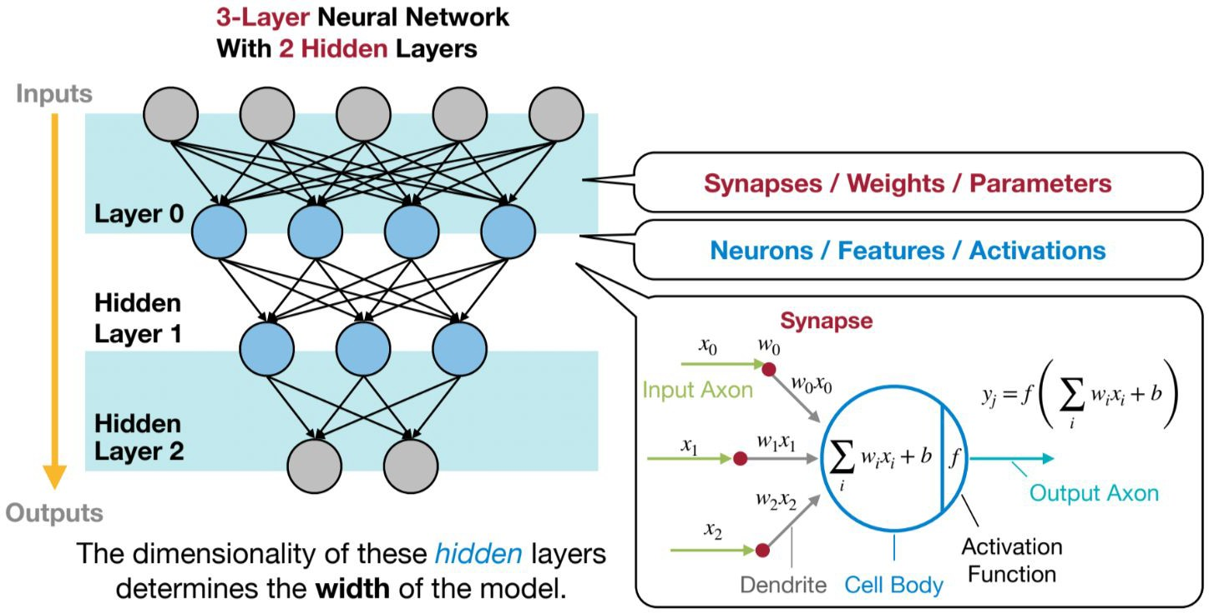
Neural Network
https://hanlab.mit.edu/courses/2023-fall-65940

Slide 7
Agenda
Neural network: terminology
Common building block: layer
Convolution neural network
Lab 2: object detection

Slide 8
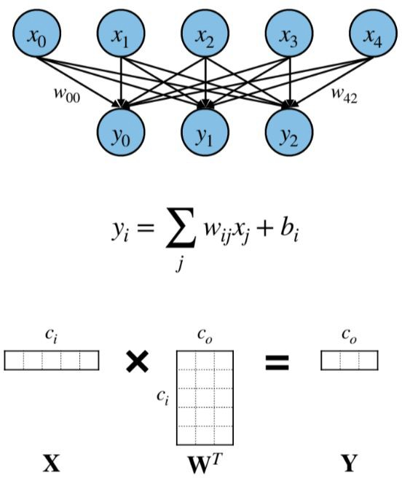
Fully-Connected (FC) Layer
https://hanlab.mit.edu/courses/2023-fall-65940

Slide 9
Tensor as in Tensorflow
In ML context, Data Tensor is simply a multidimensional array
Strict math, Scalar, Vector, Tensor
Multi-linear mapping between set of domain vector spaces to a range vector space

Slide 10
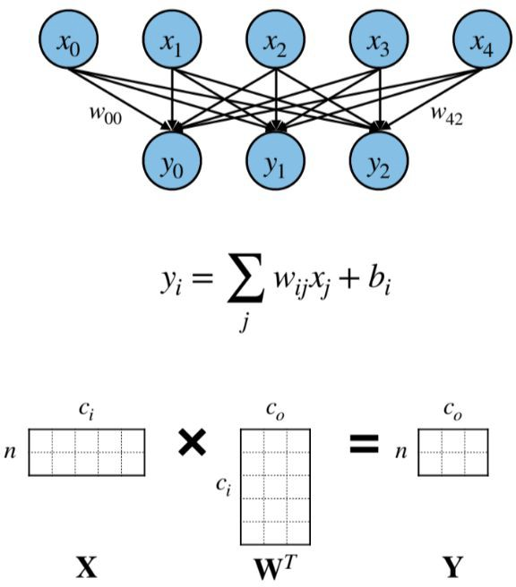
Fully-Connected (FC) Layer
https://hanlab.mit.edu/courses/2023-fall-65940

Slide 11
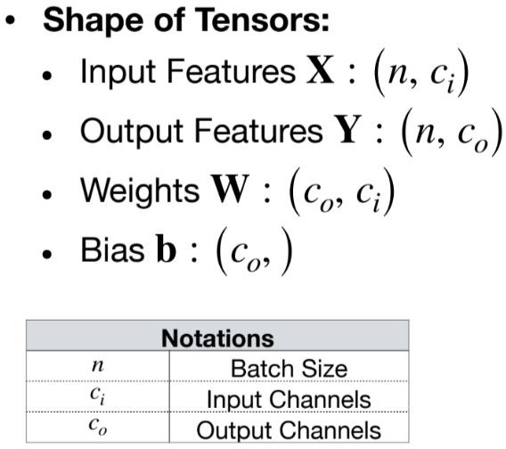
Fully-Connected (FC) Layer
Everything is a tensor!
https://hanlab.mit.edu/courses/2023-fall-65940

Slide 12
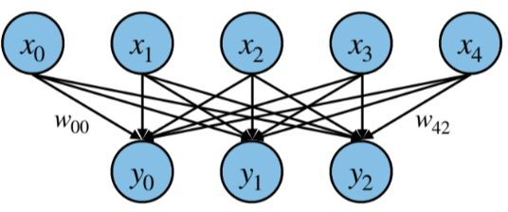
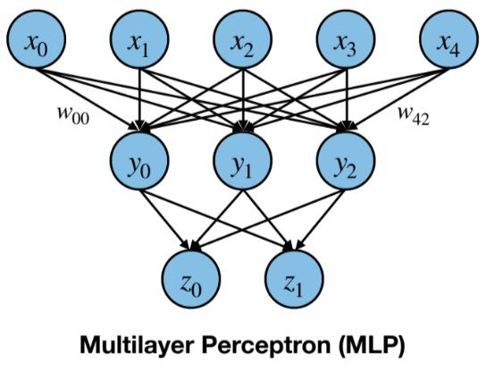
Multilayer Perceptron (MLP)
https://hanlab.mit.edu/courses/2023-fall-65940

Slide 13
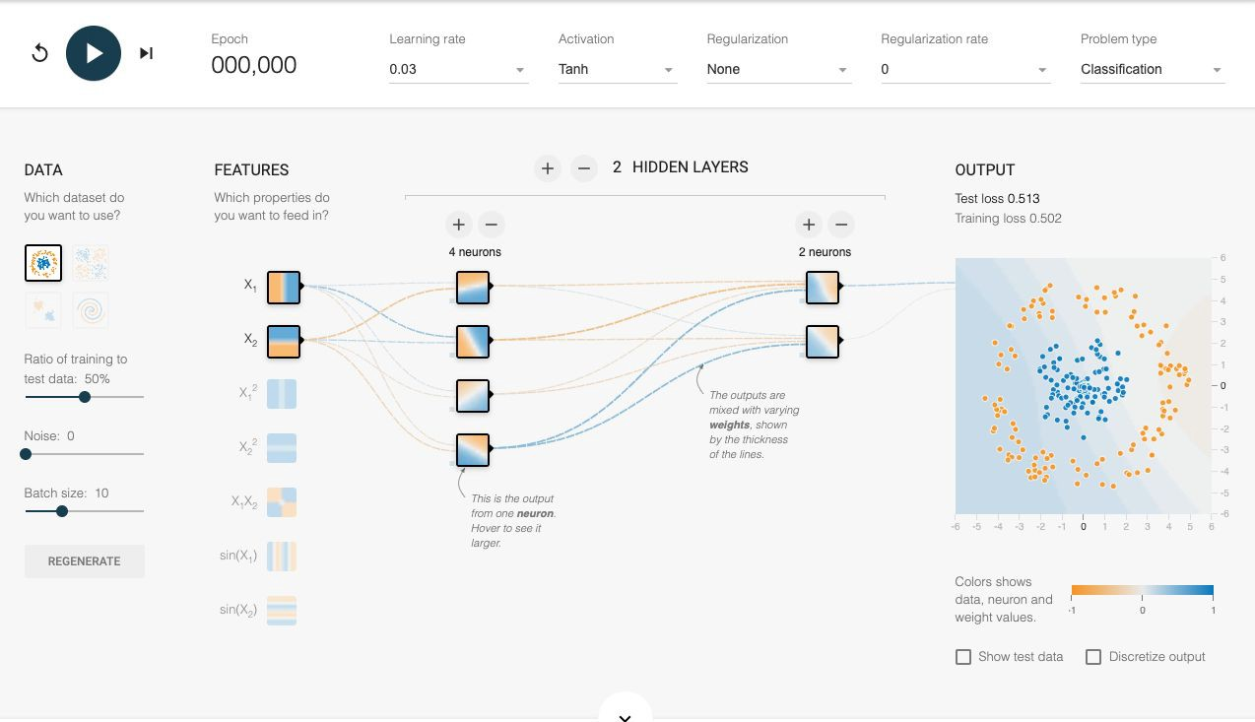
Demo: Tensorflow Playground
A Neural Network Playground
Neuron is one kind of simple classifier / filter

Slide 14
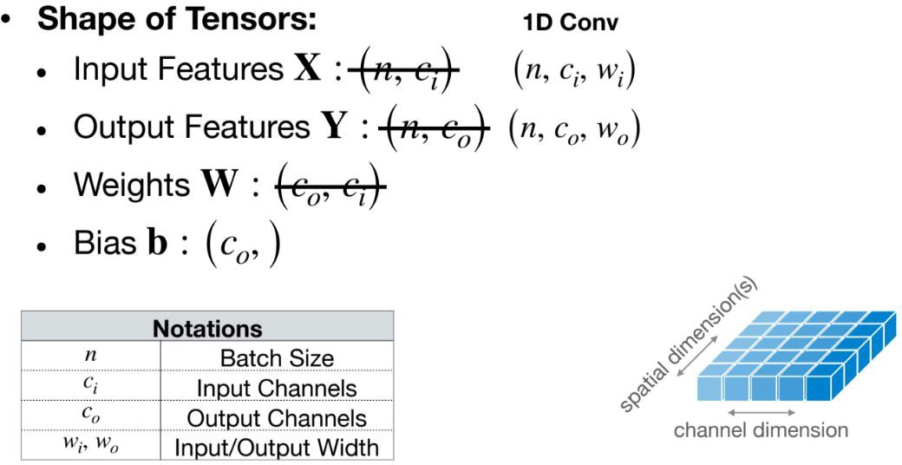
Convolution Layer
https://hanlab.mit.edu/courses/2023-fall-65940

Slide 15
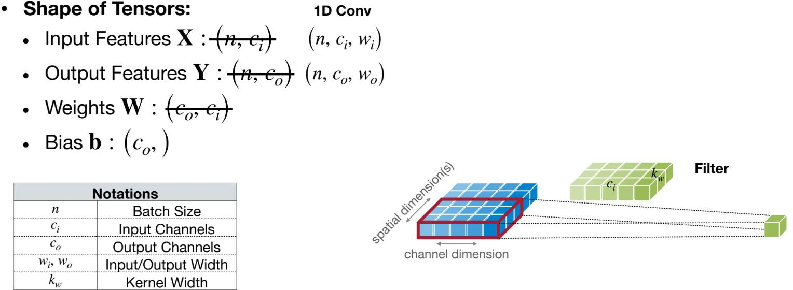
Convolution Layer
https://hanlab.mit.edu/courses/2023-fall-65940

Slide 16
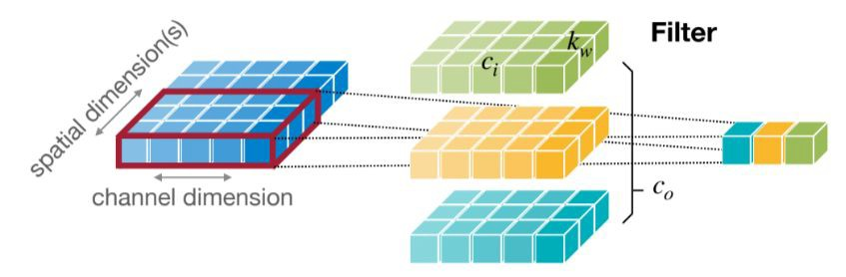
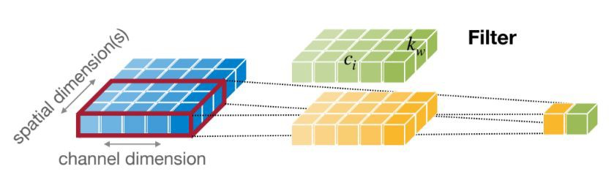
Convolution Layer
Weight sharing
https://hanlab.mit.edu/courses/2023-fall-65940

Slide 17
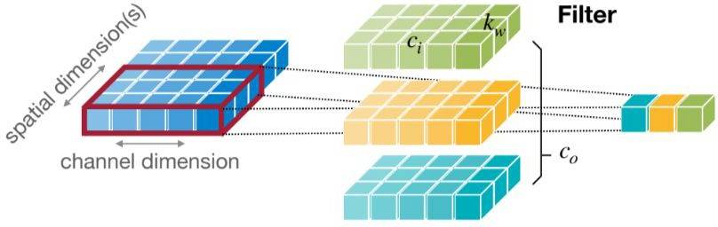
Convolution Layer
Convolve the same weight
(filter) over 1D spatial dimension
https://hanlab.mit.edu/courses/2023-fall-65940

Slide 18
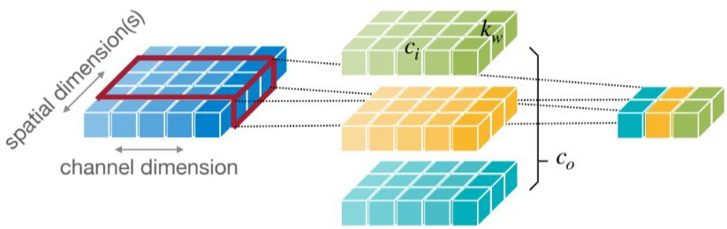
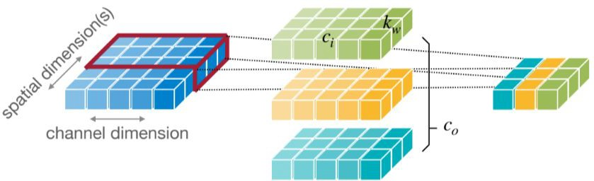
Convolution Layer
Convolute the same weight
(filter) over 1D spatial dimension
https://hanlab.mit.edu/courses/2023-fall-65940

Slide 19
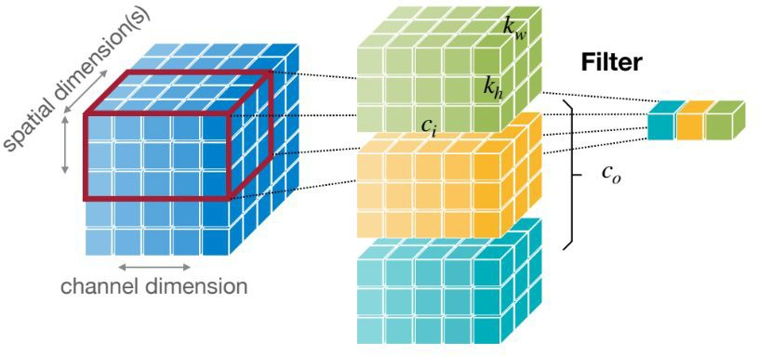
Convolution Layer
2D Convolution
Over 2D spatial
https://hanlab.mit.edu/courses/2023-fall-65940

Slide 20
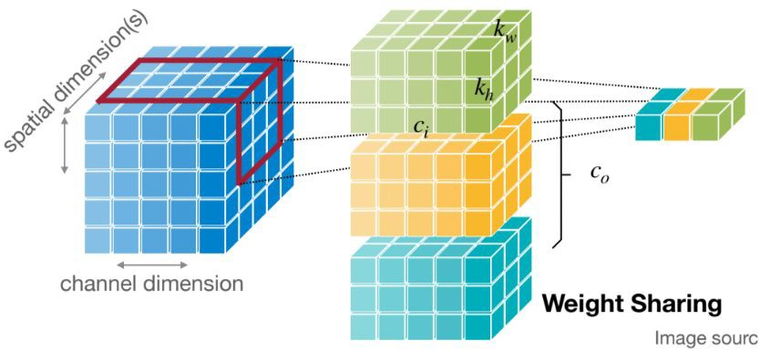
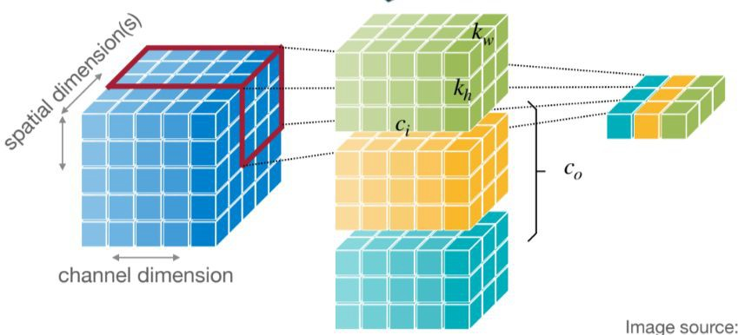
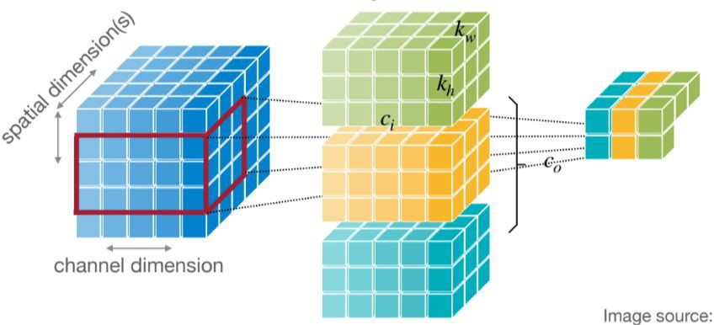
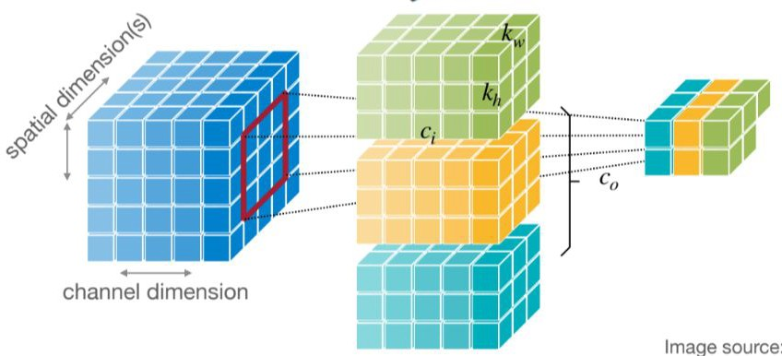
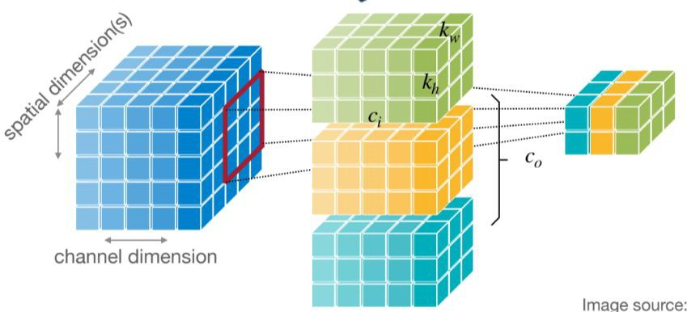
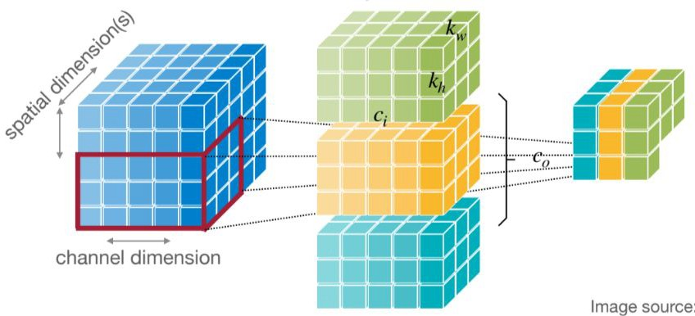
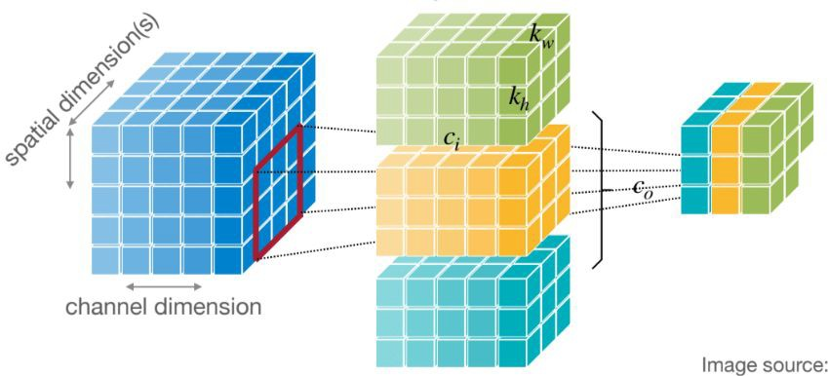
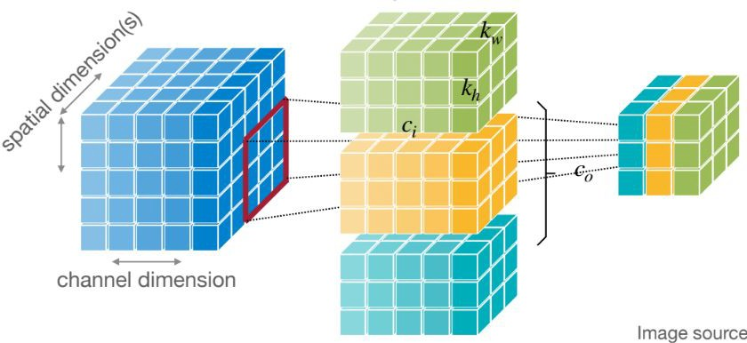
Conv2D

Slide 21
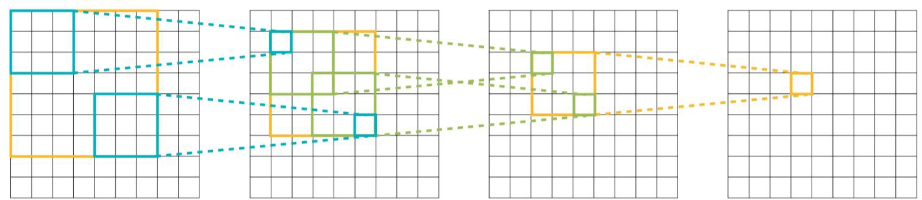
Receptive Field
The dimension of the original input that impact on one output value
https://hanlab.mit.edu/courses/2023-fall-65940

Slide 22
Receptive Field
The dimension of the original input that impact on one output value
https://hanlab.mit.edu/courses/2023-fall-65940

Slide 23
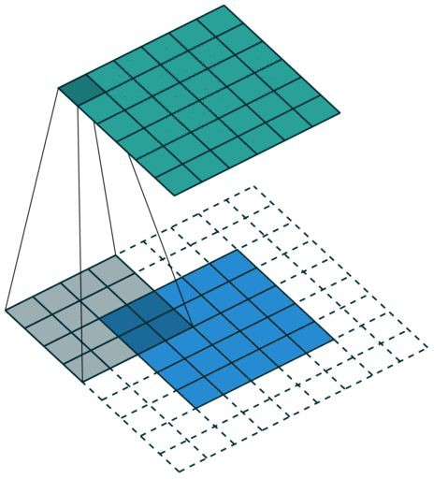
Padding
https://github.com/vdumoulin/conv_arithmetic

Slide 24
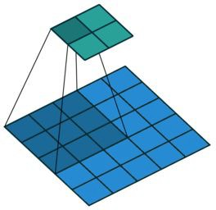
Strides
https://github.com/vdumoulin/conv_arithmetic

Slide 25
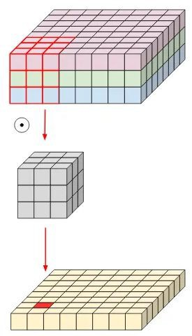
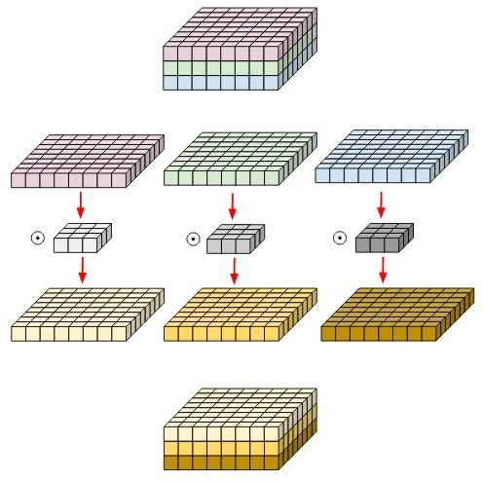
Depthwise Convolution Layer
https://medium.com/@zurister/depth-wise-convolution-and-depth-wise-separable-convolution-37346565d4ec

Slide 26
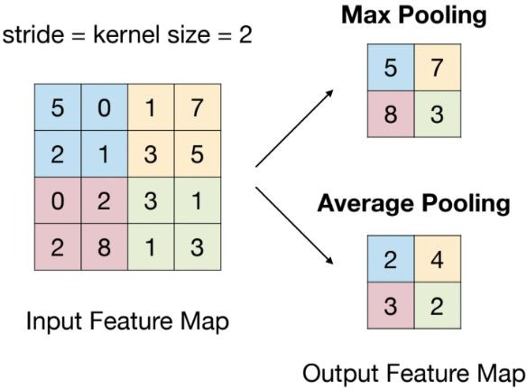
Pooling Layer
Pool the feature in the receptive field
Simple math operation
No learnable parameters
https://hanlab.mit.edu/courses/2023-fall-65940

Slide 27

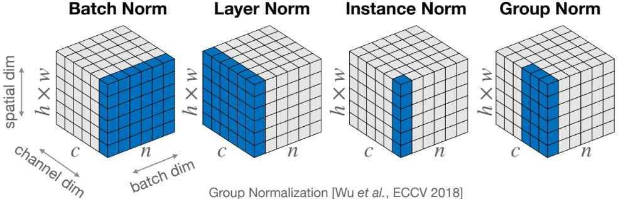
Normalization Layer
Normalize a group of features to a mean and standard deviation
https://hanlab.mit.edu/courses/2023-fall-65940

Slide 28
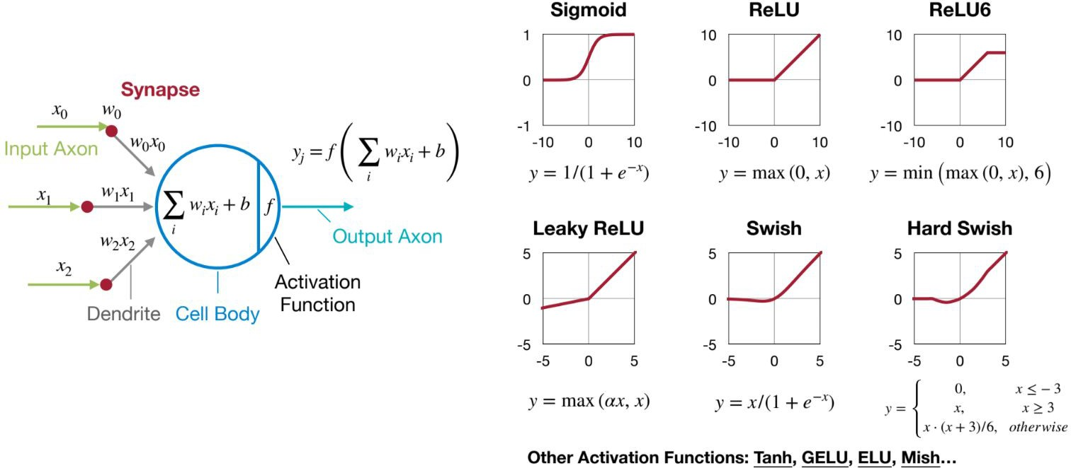
Activation Function
Introduce non-linearity to the neural network
https://hanlab.mit.edu/courses/2023-fall-65940

Slide 29
Agenda
Neural network: terminology
Common building block: layer
Convolution neural network
Lab 2: object detection

Slide 30
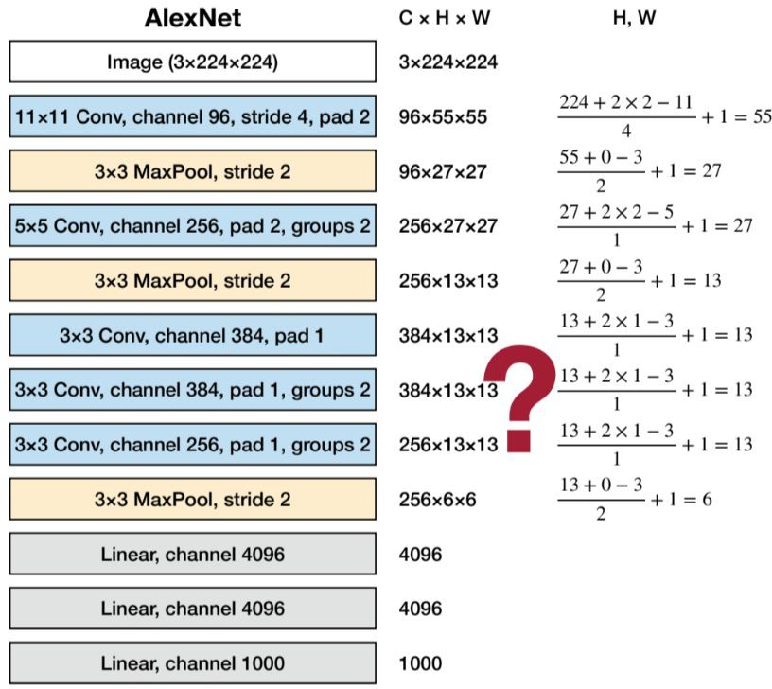
AlexNet
Trained on ImageNet
Classify RGB images of 224X224 into 1000 classes
ImageNet Classification with Deep Convolutional Neural Networks [Krizhevskyet al., NeurIPS 2012]

Slide 31
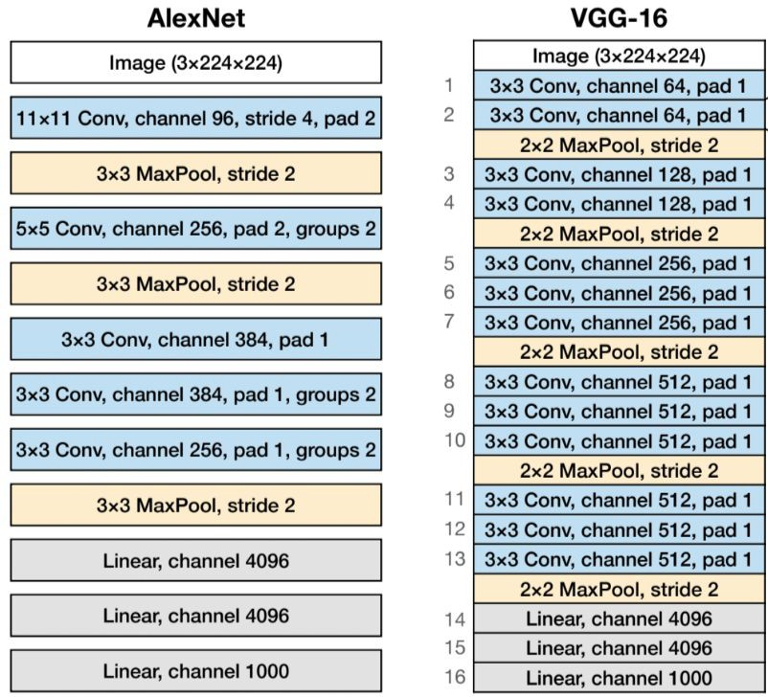
VGG-16
Very Deep Convolutional Networks for Large-Scale Image Recognition
[Simonyanet al., ICLR 2015]

Slide 32
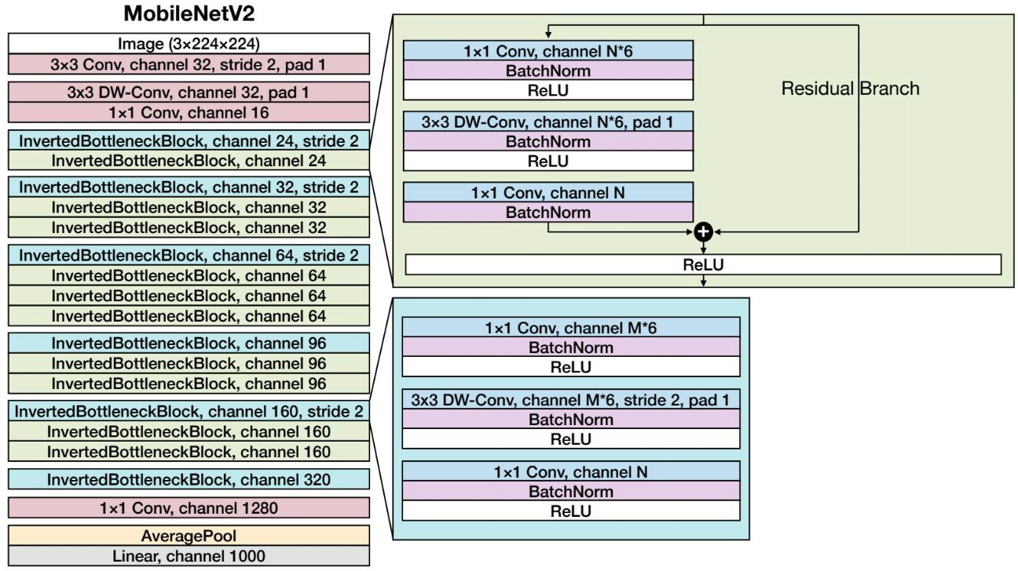
MobileNetV2

Slide 33
Model Zoo
Classification
models/research/object_detection/g3doc/tf2_classification_zoo.md at master · tensorflow/models · GitHub
Detection
models/research/object_detection/g3doc/tf2_detection_zoo.md at master · tensorflow/models · GitHub

Slide 34
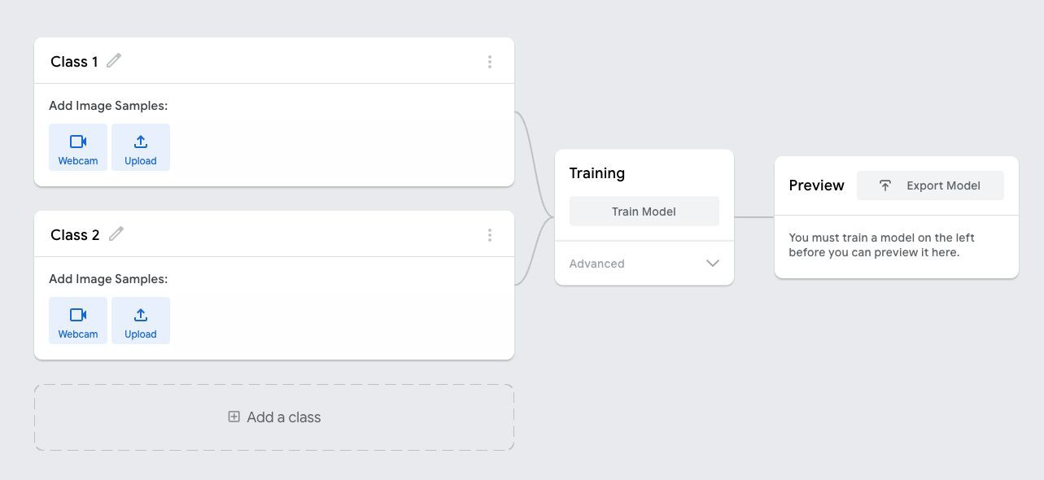
Demo: Teachable Machine
Teachable Machine
Auto-optimization, deployment ready:
Tensorflow.js, Tensorflow (Keras, SavedModel), Tensorflow lite (quantized, edge TPU)

Slide 35
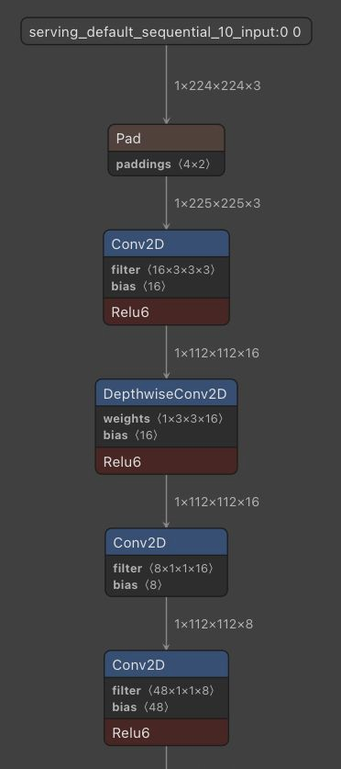
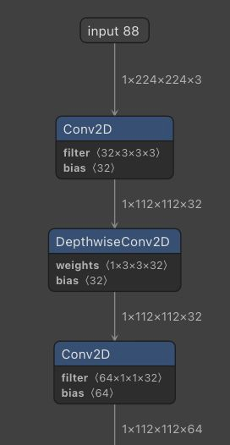
Demo: Netron.app
Netron App
Model we trained on Teachable Machine
MobileNet v1 (Downloaded)

Slide 36
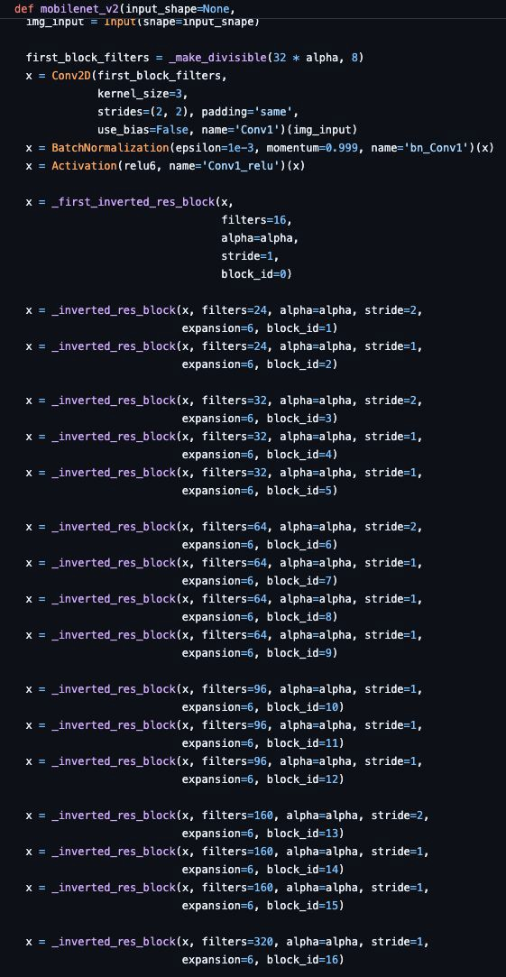
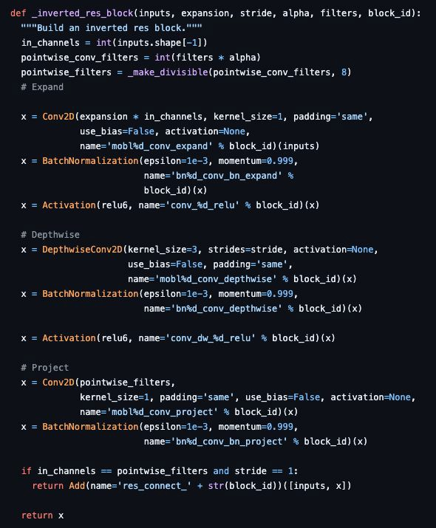
Coding your first DNN!
Example Implementations:
MobileNet v2
Optional:
Code a very simple neural net
Package it into a docker
Run on Jetson Nano
Lab 2 bonus point!

Slide 37
Summary
Neural network: terminology
Neuron, Synapse, Activation, Weight, etc.
Common building block: layer
FC, Conv, Conv2D, Depthwise Conv
Receptive field, padding, strides
Pooling, Normalization
Convolution neural network
Alexnet, VGG16, MobileNetv2
Tensorflow, Tensorflow Lite

Slide 38
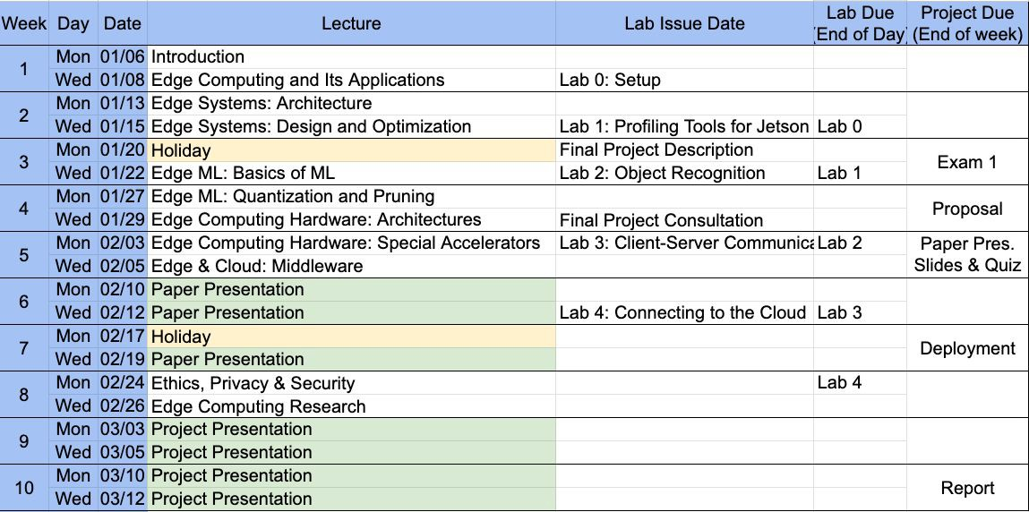

Slide 39
Next Lecture
Making ML more efficient on the edge
Quantization & pruning

